Slide 1
Regression

Slide 2
 | Numeric IV | Nominal IV
Numeric DV | correlation or regression
Count or frequency DV | logistic regression

Slide 3
Correlation and regression
Have to decide which is predictor (IV) and which is outcome (DV)
  x-axis
  y-axis
SCATTER PLOT!

Slide 4
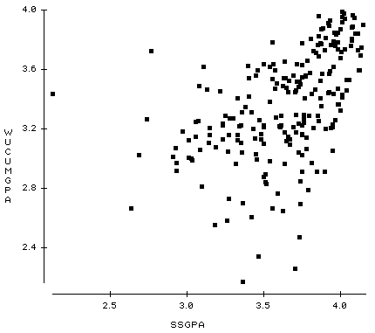
DANVA
NTB

Slide 5
Regression
Predict score for DV (y) using score for IV (x)
  What would this be for the variables on the last slide?

Slide 6
DANVA
NTB
How would we choose which is best?

Slide 7
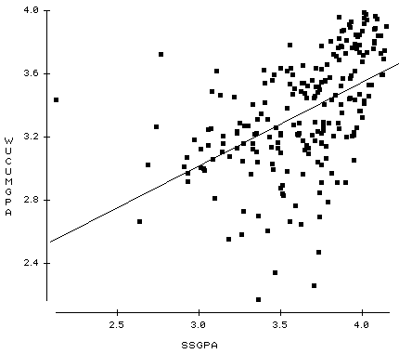
Goal: trying to minimize sum of squared errors
DANVA
NTB
“Least squares” criterion

Slide 8
Least squares criterion
line for which predicted Y (using formula) are closest to the actual Y
The line that minimizes the squared error
  ∑(Y- Ŷ)²
  how far off we were in predicting Y based on X squared

Slide 9
Formula (to predict Y based on X)
  Ŷ = a + b(X)
  b = Regression Coefficient (amount of change in y for every unit change in x)
  a = Regression constant (the intercept; what predicted y (or Ŷ) is if x is 0)

Slide 10
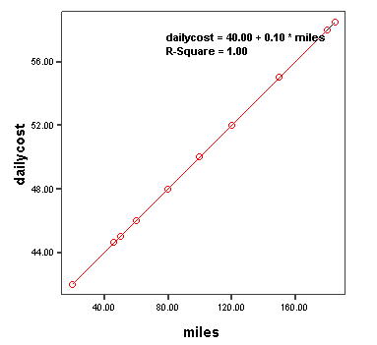
Common application of y=a + bx
Cost of renting a car is $40 per day +10 cents/mile
  Y = cost of renting a car
  Intercept (a) = 40 dollars
  Slope (b) = 10 cents per mile
  What is the price if you drive 10 miles?

Slide 11
Try it out
A commission sales person makes $50 per day no matter what they sell, but they also get 10% of sales.
Y = daily income
a (intercept) = $50 dollars b = .10 X = sales
so y=$50+.10X
Grades for an assignment: you get 10 points for completing the assignment plus an additional 1 point for each question right.
  Y = grade on assignment
  a =10 points b=1 point X=# of questions right
  so: y = 10 + X
Notes:
For second one, what is Y? what is A? what is B? what is X?

Slide 12
An example
A psychologist reports that the number of friends kids have predicts time spent outside in hours such that a = 1 & b = .25. What is the regression equation?
Ŷ = 1 + .25x
What do the terms a and b refer to?
a = point at which the regression lines crosses the y-axis (without any friends, how much time outside)
b = slope of the line (how much #hrs increases with each friend)
What is the predicted time outside for a kid who has 4 friends?
2 hours.

Slide 13
Regression Equations
Unstandardized: Ŷ = a + bX
  a and b reflect the actual scale of the variables
    for each point increase in social sensitivity, there is 1.39 decrease in number of friends
    if social sensitivity is 0, then 13.82 number of friends
Standardized: Z_{Ŷ} = 0 + (β)(Z_{X})
  β reflects the predicted amount of change in y (in SD units) for each SD change in x
    for every 1 SD increase in social sensitivity, number of friends decreases .95 SDs
    a is 0, so if you are at mean social sensitivity, you are at mean number of friends

Slide 14
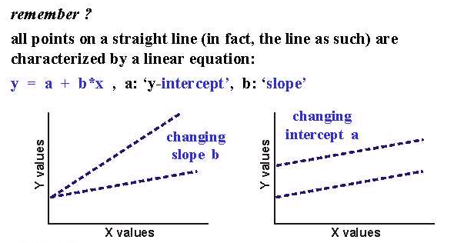
Significance Tests of a & b
The regression constant (“a”) can vary from 0:
The regression coefficient (“b”) can vary from 0:

Slide 15
Hypothesis Testing
Is b (or β) significantly different from 0?
  0 means that knowing x gives you no info about y
Is a significantly different from 0?

Slide 16
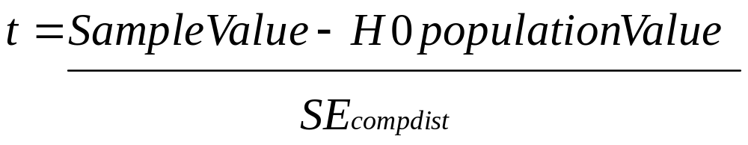
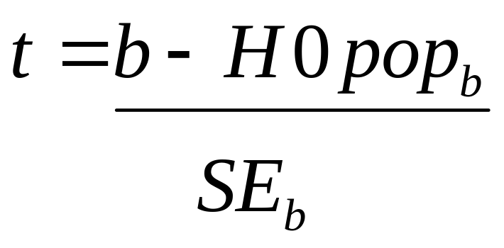
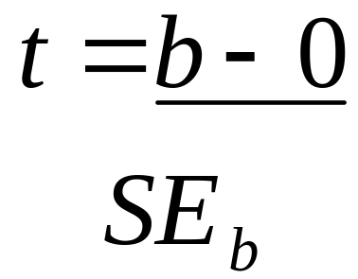
General t formula!
For a test of whether “b” differs from 0, we will have:
- OR -

Slide 17
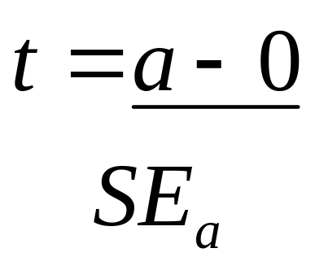
For a test of whether “a” differs from 0, we will have:

Slide 18
NHST
We use what we learned about sampling distributions to figure out the probability of that b or a (so we can know if its extreme enough to reject the null)
If we have an extreme enough t, we feel confident rejecting the null hypothesis (that there is no effect)
p < .05

Slide 19
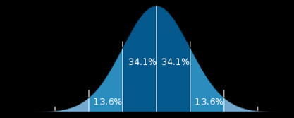
Sampling distribution
…Z is just one “test statistic” that can have a sampling distribution
  All test-statistics (Zs, Ts, Rs, Fs, Chi-squares, Bs) have their own sampling distribution
  Same logic and overall process apply for those
Sampling distribution

Slide 20
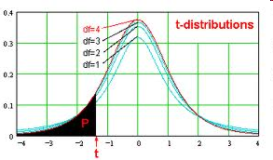
Distribution is not quite “normal”
Differences:
tails
vary shape
  As df -> ∞…
Notes:
Becomes more like a z-distribution

Slide 21
NHST
We use what we learned about sampling distributions to figure out the probability of that r (so we can know if its extreme enough to reject the null)
If we have an extreme enough r, we feel confident rejecting the null hypothesis (that there is no effect)
p < .05
Notes:
R is both a descriptive statistic (like reporting Ms or Bs) but also a test-statistic, as can get p value associated with it. ALSO its interpretable directly as effect size!

Slide 22
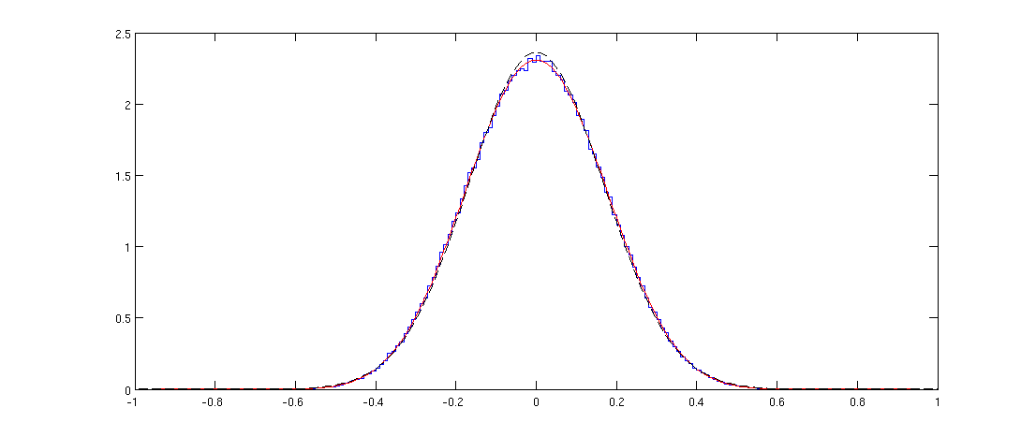
Sampling distribution of r

Slide 23
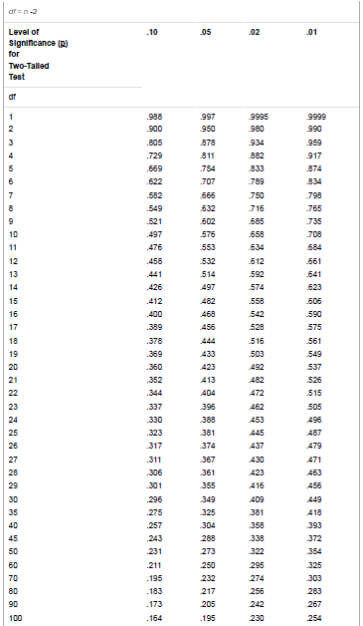

Slide 24
If bivariate regression
β = r
  Lets verify…
Notes:
SHOW age and grit

Slide 25
More advanced
Multiple regression
Dummy coding
Interpreting multiple regression
3Ms of multiple regression
Mediation
Moderation
Mulicolinarity

Slide 26
Multiple regression
If have 2+ IVs and a continuous DV, could do factorial ANOVA or multiple regression
depends on if IVs are categorical or continuous!
  ONLY if ALL IVs are categorical, use factorial ANOVA
  at least one of them is continuous, you must use multiple regression
    if have categorical IV(s) as well, dummy code the categorical IV(s) and use regression

Slide 27
 | Continuous IV | Categorical IV
Continuous DV | correlation or regression
CategoricalDV (Count or frequency) | logistic regression
The principles here can be applied to logistic regression as well!!!

Slide 28
Multiple logistical regression
If have 2+ IVs and a categorical DV, could do log-linear or multiple regression
depends on if IVs are categorical or continuous!
  ONLY if ALL IVs are categorical, use log-linear
  at least one of them is continuous, you must use logistic regression
    if have categorical IV(s) as well, dummy code the categorical IV(s) and use logistic regression

Slide 29
Multiple regression thought experiment
Come up with a set of variables in which you have 2 or 3 predictor variables (IVs) that you think may predict a single DV
  Continuous DV
  Categorical DV

Slide 30
Multiple regression
Predicting Income from:
  Intelligence & Education
Y = Income
Unexplained variance = .735
“Unique” contribution of intelligence
.105
.015
“Unique” contribution of Education
.145
X₂ = Intelligence
X₁ = Educ.

Slide 31
Multiple regression
If beta significant in multiple regression, that means an IV predicts the DV above and beyond the other IVs
  when controlling for (or holding constant) the other variables

Slide 32
Multiple regression output
DV = relationship satisfaction
Variable Coefficient T value prob
Constant 2.526 4.40 <.0001
Height -0.100 -5.36 <.0001
Age -2.652 -4.35 <.0001
What does it mean? Interpret!

Slide 33
Dummy Coding
Transform categorical variable into a series of 0-1 variables (dummy codes)
Ex: Gender … 0 = F, 1 = M
Choose a baseline group
One variable indicating each of the other variables
Total number of dummy variables is number of categories in original variable – 1

Slide 34
An Example of Dummy Coding
Consider the variable Academic Department
  Three levels: 1=Family Studies, 2=Biology, and 3=Business
  If one enters this variable into the regression model, it is must be made into numeric variable(s)!
  Can reduce to 2 variables (# of categories – 1)
    Business is reference category
    Create two variables FS & Bio
    If participant is in FS: FS score = 1 & Bio score = 0
    If participant is in Bio: FS score = 0 & Bio score = 1
    If participant is in business: FS score = 0 & Bio score = 0

Slide 35
Dummy Coded Matrix
 |  | FS | Biology
Family Studies |  | 1 | 0
Biology |  | 0 | 1
Business |  | 0 | 0

Slide 36
Dummy Coding
What would dummy codes be for this?
Ex: Ethnicity
  1 = Caucasian
  2 = Latino
  3 = African American
  4 = Asian
For this?
  1 = Male
  2 = Female

Slide 37
Dummy coding
Limitation—Not comparing all groups to each other, just to the baseline/ comparison group
However, we can switch dummy coding around to test other comparisons
Which one is zero is important even if only 2 groups (will see an example of that soon, in moderation)

Slide 38
Multiple regression output
DV = relationship satisfaction
Variable Coefficient T value prob
Constant 2.652 4.35 <.0001
Gender(0=F) -0.098 -5.34 <.0001
Height -0.001 -0.23 0.956
Age -2.123 -4.17 <.0001
What does it mean? Interpret!
What about the difference from the last one we saw, before we knew how to dummy code so we could enter gender?

Slide 39
Two Strategies for multiple regression
Simultaneous Regression
  Throw all predictors in at once!
  Each b is controlling for other predictors*
Hierarchical Regression
  Researcher starts with 1 predictor (so you aren’t controlling for others), then adds a second, and so on
  Change in R² (∆R²) assesses whether adding those predictors adds explanatory power
- Let’s see in the grit data…
Notes:
* Significance is if it significantly predicts above and beyond the other factors

Slide 40
Multiple regression
Predicting Income from:
  Intelligence & Education
Y = Income
Unexplained variance = .735
∆R² -- “Unique” contribution of intelligence
.105
.015
∆R² -- “Unique” contribution of Education
.145
X₂ = Intelligence
X₁ = Educ.

Slide 41
Two Strategies for multiple regression
Simultaneous Regression
  Throw all predictors in at once!
  Each b is controlling for other predictors
Hierarchical Regression
  Researcher starts with 1 predictor (so you aren’t controlling for others), then adds a second, and so on
  Change in R² (∆R²) assesses whether adding those predictors adds explanatory power
    do hierarchical regression with interaction effects (moderation), since interpretation changes once interaction term is added.
Hayes and Matthes (2009)

Slide 42
Interpreting multiple regression
Depends on how many/which IVs entered:
  just 1 IV entered: the beta for that IV is simply that IV's effect
  just 2 IVs entered: the beta for an IV is that IV’s effect controlling for the other IV (e.g., at the mean of the other IV(s))
  2 IVs and their interaction term entered: the beta for an IV is that IV’s effect when the other IV is zero
Notes:
BECAUSE YOU HAVE TO CENTER THE VARS with interaction term

Slide 43
Two Strategies for multiple regression
Simultaneous Regression
  Throw all predictors in at once!
  Each b is controlling for other predictors
Hierarchical Regression
  Researcher starts with 1 predictor (so you aren’t controlling for others), then adds a second, and so on
  Change in R² (∆R²) assesses whether adding those predictors adds explanatory power
    do hierarchical regression with interaction effects (moderation), since interpretation changes once interaction term is added.
    You must also center variables, because once interaction term is entered, its now interpreting the effect when other is ZERO

Slide 44
An example … and a preview
DV = relationship satisfaction
Variable Coefficient T value prob
Constant 2.652 4.35 <.0001
Gender(0=F) -0.098 -5.34 <.0001
ZAge -2.123 -4.17 <.0001
This comparison helps, but really we need to run simple effects tests… the second output is one, but need to run another…
Variable Coefficient T value prob
Constant 2.652 4.35 <.0001
Gender(0=F) -0.134 -5.85 <.0001
ZAge -0.001 -0.23 0.956
ZAge*Gender -0.290 -2.64 0.01
These above effects are qualified by a significant interaction; specifically, age significantly interacts with gender such that the effect of age is stronger among men (coded as 1)

Slide 45
3Ms of multiple regression
Mediation
Moderation
Mulicolinarity
Were going to work backwards…

Slide 46
“Multicollinearity”
Two or more predictor variables in the multiple regression equation are too highly correlated
Impacts
  May have a significant MODEL, but no significant individual predictors
  Significance tests of b for individual predictors will be unstable
Possible solutions
  Don’t include all variables
  Create “composite” variables that combine information

Slide 47
“Moderation”
Does the level of one variable change the relationship between two other variables
INTERACTION!

Slide 48
Moderation
A research article says “Gender moderates the relationship between self-esteem and social network size." What does this mean?
The relationship between self-esteem and SNS is different depending on whether you are male or female.
What else would you want to know?

Slide 49
“Moderation”
Does the level of one variable change the relationship between two other variables
INTERACTION!
If…
  for men, higher numbers of sexual partners is associated with higher levels of self esteem
  for women, higher numbers of sexual partners is associated with lower self-esteem
Then, gender moderates the relationship between number of sexual partners and self-esteem

Slide 50
Ex. of Moderation
IV1: Measured loneliness
IV2: Manipulated optimism
  Primed optimism or control
DV: Concern with and avoidance of interactions

Slide 51
Concern and avoidance
Predictor Beta
Z-scored loneliness 0.54***
Prime(0=control) 0.01
Z-Loneliness 0.69***
Z-Loneliness*Prime(0=control) -0.45**
simple effects tests!
Prime(0=prime) -0.01
Can also just tell by pattern of beta weights (pos v neg)…
Z-Loneliness 0.01
Z-Loneliness*Prime(0=prime) 0.45**
There is a significant interaction
In the control condition (condition = 0), loneliness predicts more concern and avoidance. And, at the mean of loneliness (Z-Loneliness = 0)), priming condition has no effect.
In the prime condition (condition = 0), loneliness does not predict concern and avoidance. And, as mean of loneliness hasn’t changed (Z-Loneliness = 0), priming condition still has no effect.
**p < .01; ***p < .001

Slide 52
Ex. of Hierarchical regression building to moderation
DV = vigilance
Variable Coefficient T ratio prob
Constant 0.0 0.0 1.00
Traitanx(std) 0.63 6.32 <.001
What does this mean?

Slide 53
Ex. of Hierarchical regression building to moderation
DV = vigilance
Variable Coefficient T ratio prob
Constant 0.0 0.0 1.00
Condition(1=P) -0.19 -2.34 0.02
Traitanx(std) 0.54 5.75 <.001
What does this mean?
Compared to those in the control condition, those in the promotion prime condition (condition = 1) have lower “vigilance” score, controlling for anxiety.
Controlling for condition (regardless of condition), anxiety is associated with increased “vigilance”

Slide 54
Ex. of Hierarchical regression building to moderation
DV = vigilance
Variable Coefficient T ratio prob
Constant 0.0 0.0 1.00
Condition(1=P) -0.07 -1.46 0.14
Traitanx(std) 0.75 6.75 <.001
Tranx(std)*cond -0.29 -2.64 0.01
In the control condition (condition = 0), anxiety increases vigilance. However, at the mean of anxiety (Traitanx(std) = 0), condition does not have a significant effect on vigilance
These effects are qualified by a significant interaction; specifically, anxiety significantly interacts with condition such that the effect of anxiety is weaker in the prime condition (for which condition=1)

Slide 55
Ex. of Hierarchical regression building to moderation
DV = vigilance
Variable Coefficient T ratio prob
Constant 0.0 0.0 1.00
Condition(0=P) 0.07 1.46 0.14
Traitanx(std) 0.10 1.86 0.08
Tranx(std)*cond 0.29 2.64 0.01
In the prime condition (condition = 0), anxiety only marginally increases vigilance.
  as the mean of anxiety remains the same (Traitanx(std) = 0), condition still does not have a significant effect on vigilance
Can also do simple effects tests ABOVE and BELOW the mean of continuous variables. Because it’s centered (and we used Z-scores), you can create new variables (like reversing dummy):
1SD above = Traitanx(std) – 1; 1SD below = Traitanx(std) + 1
simple effects tests!
Doesn’t have to be 1

Slide 56
Ex. of Hierarchical regression building to moderation
DV = vigilance
Variable Coefficient T ratio prob
Constant 0.0 0.0 1.00
Condition(1=P) -0.07 -1.46 0.14
Traitanx(std) 0.75 6.75 <.001
Tranx(std)*cond -0.29 -2.64 0.01
However, could even determine the nature of the interaction without simple effects tests (just by observing pattern of results) --- but simple effects tests are easier AND tell you if its significant within each condition
Condition = 1 (prime) has neg effect (b/c neg intx term) on pos. effect of anxiety on vigilance – so weaker (b/c neg*pos = neg) pos. effect of anxiety in prime cond.

Slide 57
From the beginning
DV = relationship satisfaction
Variable Coefficient T ratio prob
Constant 50.723 5.25 <.001
Gender(0=F) -4.212 -5.64 <.001
Height(std) 0.202 0.10 0.92
Age(std) -5.123 -5.62 <.001
There is an effect of age controlling for gender and height
There is an effect of gender controlling for age and height
There is no effect of height controlling for gender and age

Slide 58
From the beginning
Gender = 1 (male) has neg effect (b/c neg intx term) on neg. effect of age on rel sat – so stronger (b/c neg*neg = pos) neg. effect of age for males
DV = relationship satisfaction
Variable Coefficient T ratio prob
Constant 50.723 5.25 <.001
Gender(0=F) -4.212 -5.64 <.001
Height(std) 0.202 0.10 0.92
Age(std) -0.212 -0.13 0.85
Age(std)*gend -3.316 -2.58 0.01
There is no effect of age at gender = 0 (female) & height(std) = 0 (mean)
There is an effect of gender at age(sd) = 0 & height(std) = 0 (means)
There is no effect of height at gender = 0 (female) & age(std) = 0
Female (0) reduces the effect of age on relationship satisfaction
If unclear, graph predicted means instead – but its traditional to effects code (-1 & 1) instead of dummy

Slide 59
Vigilance ex
Rel sat ex
Dummy = 1 (prime) has neg effect on (b/c neg intx term) pos. effect of anxiety on vigilance – so weaker (b/c neg*pos = neg) pos. effect of anxiety for prime condition
Dummy = 1 (X group) has neg effect on (b/c neg intx term) neg. effect of age on rel sat – so stronger (b/c neg*neg = pos) neg. effect of age for males
Dummy = 1 (X group) has neg effect on (b/c neg intx term) pos. effect of IV on DV – so weaker (b/c neg*pos = neg) pos. effect of IV for X group
Dummy = 1 (X group) has neg effect on (b/c neg intx term) neg. effect of IV on DV – so stronger (b/c neg*neg = pos) neg. effect of IV for X group
What if the interaction terms had been positive?
Dummy = 1 (prime) has pos effect on (b/c pos intx term) pos. effect of anxiety on vigilance – so stronger (b/c pos*pos = pos) pos. effect of anxiety for prime
Dummy = 1 (male) has pos effect on (b/c pos intx term) neg. effect of age on rel sat – so weaker (b/c pos*neg = neg) neg. effect of age for males
Dummy = 1 (X group) has pos effect on (b/c pos intx term) neg. effect of IV on DV – so weaker (b/c pos*neg = neg) neg. effect of IV for X group
Dummy = 1 (X group) has pos effect on (b/c pos intx term) pos. effect of IV on DV – so stronger (b/c pos*pos = pos) pos. effect of IV for X group

Slide 60
A hypothetical output
DV = general happiness
Variable Coefficient T ratio prob
Constant 3.632 4.29 <.001
Gender(0=F) 0.315 -5.44 <.001
Height(std) 0.001 0.01 0.99
Age(std) -0.223 -4.47 <.001
Heig(std)*gend 0.316 1.98 0.04
Notes:
Dummy = 1 (male) has pos effect on (b/c pos intx term) pos. effect of height on DV – so stronger (b/c pos*pos = pos) pos. effect of height for males

Slide 61
“Mediation”
A variable mediates a relationship between two variables if it explains that relationship
Time spent partying Grades
Time spent partying Time spent studying Grades

Slide 62
Ex. of Mediation
Measured loneliness
Measured prevention-focused goal-pursuit
Measured concern and avoidance

Slide 63
You have evidence for mediation when:
1. IV predicts DV
2. IV predicts mediator
3. When you enter IV and mediator in one equation to predict DV, IV no longer predicts DV but mediator does
  IV does NOT uniquely predict DV above and beyond mediator

Slide 64
First establish that pattern
Prevention
β = .23, p = .02
β = .29, p = .002
Loneliness
β = .19, p = .05
Concern and disengagement
Reduced to: β = .12, ns
Now that pattern is established, test for significance (sobel, bootstrapping, etc.)

Slide 65
Moderation vs. mediation
Which do you use when?

Slide 66
Straight from the horse’s mouth:
Baron, R.M., & Kenny, D.A. (1986)
Moderation vs. mediation
Mediator-oriented research
more interested in the mechanism of the predictor variable
when a strong relation between the predictor and the criterion variable, and one wants to explain why
Moderator research
more interested in undersanding the conditons underwhich the predictor varaible exerts its influence
when there is an inconsistent (or an unexpectedly weak) relation between a predictor and a criterion variable
    E.g., grit’s perserverence factor and preformance (forthcoming)

Slide 67
Other topics to discuss
Mediated moderation
Moderated mediation
Mediation or moderation with logistic regression

